Slide 1
Heart Disease Predictor
Raunaque (2021278)
Satwik Rampelli (2021276)
Utkarsh Kumar Singh (2021107)
Manshaa Kapoor (2021540)
Varsha Bhaskar (2021499)

Slide 2
Abstract : Motivation
Cardiovascular diseases (CVDs) remain the leading cause of death globally, highlighting the urgent need for efficient diagnostic tools to address this critical health issue.
The research focuses on developing a machine learning model that utilizes readily available medical data, such as age, blood pressure, and cholesterol levels, to predict heart disease risk effectively.
By comparing various machine learning algorithms, the study aims to identify the most accurate and reliable method for early diagnosis, ultimately improving patient care.
This predictive approach offers a scalable solution that can enhance healthcare accessibility, particularly in low-income regions where traditional diagnostic methods may be limited.

Slide 3
Problem Statement
Current approaches need specific equipment and knowledge, which can be expensive and difficult to get in isolated or impoverished areas. In order to provide a more economical, effective, and precise method of early heart disease risk prediction
The goal of this project is to create a machine learning model that uses medical information like age, blood pressure, and cholesterol levels to predict heart disease.
Through ablation investigations and hyperparameter adjustment, the emphasis is on comprehending and evaluating model performance.
An understandable and precise prediction model that can help with early heart disease diagnosis will be the end result.

Slide 4
Literature Review
Heart Disease Prediction Using Machine Learning :
The authors use four algorithms: MLP, SVM, RF, and NB.
They preprocess the data, perform feature selection, and evaluate the models based on accuracy, precision, recall, and F1-score.
The study found that SVM performed the best with 91.67 percent accuracy, emphasizing the importance of model selection and data preprocessing in healthcare applications.
2. Predict Heart Disease using Machine Learning Algorithms :
The study explores heart disease prediction using machine learning algorithms like logistic regression, K Nearest Neighbours (KNN), and Random Forest.
It improves prediction accuracy by using medical attributes such as age, gender, and cholesterol levels.
The KNN model performed best, achieving 88.52 per cent accuracy, aiding in more efficient and cost-effective heart disease diagnosis.

Slide 5
Dataset Description
1. The dataset contains comprehensive medical, demographic, and lifestyle information from patients aimed at predicting the risk of a heart attack.
2. Size and Structure: The dataset has a total of 8,700 data samples where each row represents a patient, and has the following key columns:
• Medical Features: Attributes like Age, Cholesterol, Blood Pressure, Heart Rate, BMI, Triglycerides, and Diabetes.
• Lifestyle Variables: Features such as Smoking, Alcohol Consumption, Exercise Hours Per Week, Physical Activity Days Per Week, Diet (categorized as Healthy, Average, Unhealthy), Stress Level, Sedentary Hours Per Day, and Sleep Hours Per Day. These provide insight into the patient's daily habits and overall health.
• Demographic Features: Information about Sex, Income, Country, Continent, and Hemisphere. These help identify geographic and socioeconomic factors in heart health.
• Target Variable: Heart Attack Risk is a binary label (1 for at risk, 0 for not at risk), which represents the likelihood of a heart attack for each patient.

Slide 6
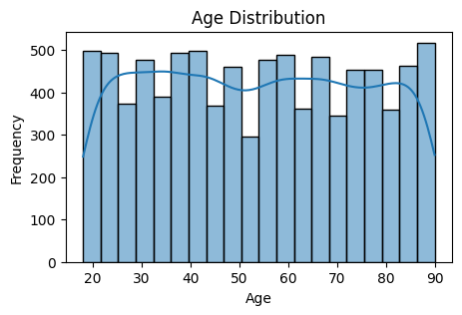
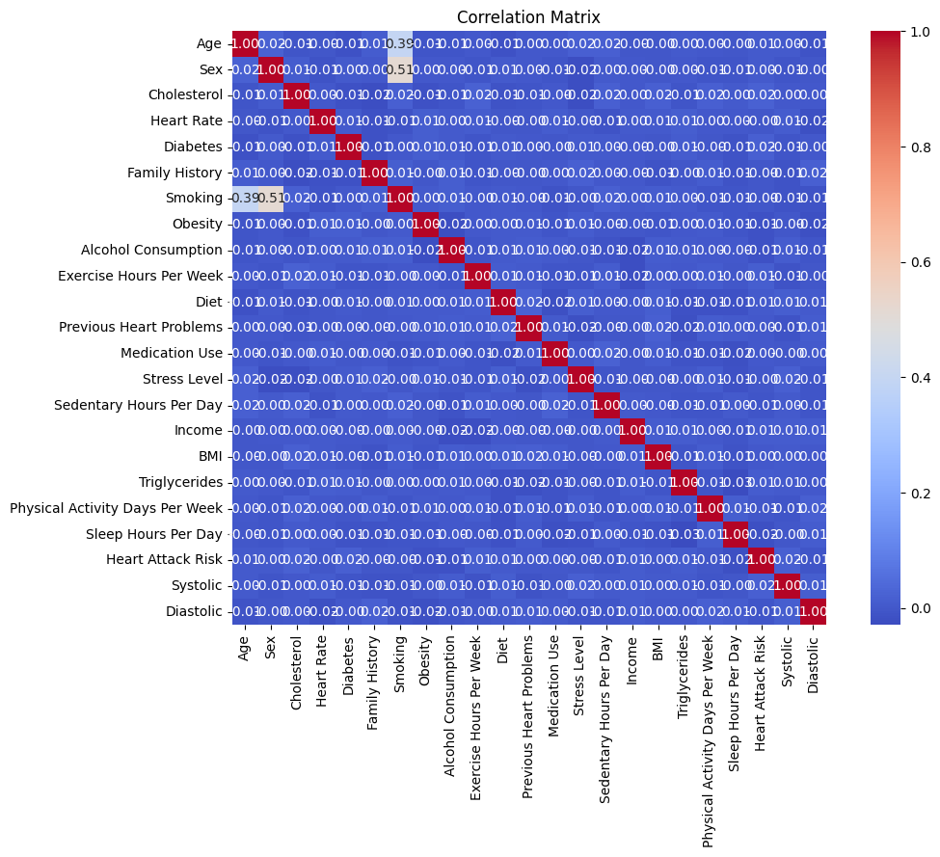
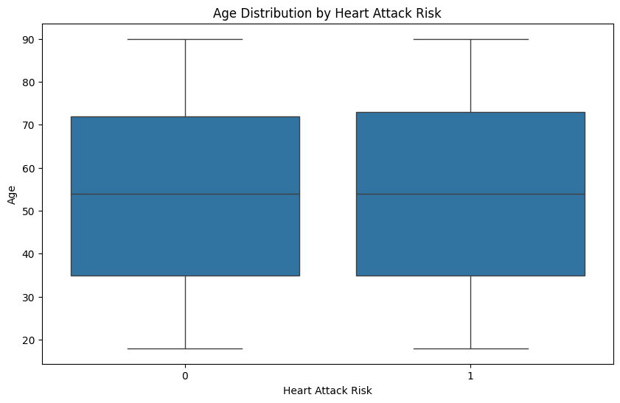
Dataset Visualisations
Heatmap to show the correlation matrix between numerical features
Histogram with KDE for the ‘Age’ column
Box plog to compare ‘Age’ distribution across ‘Heart Attack Risk’ categories

Slide 7
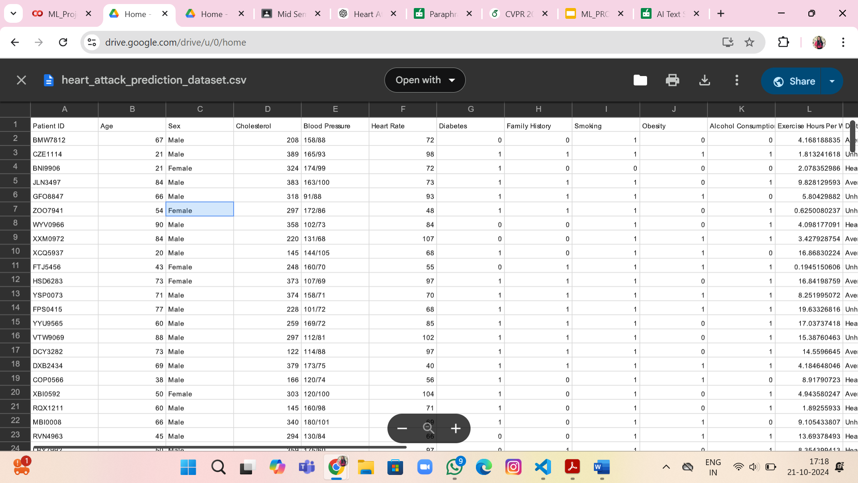
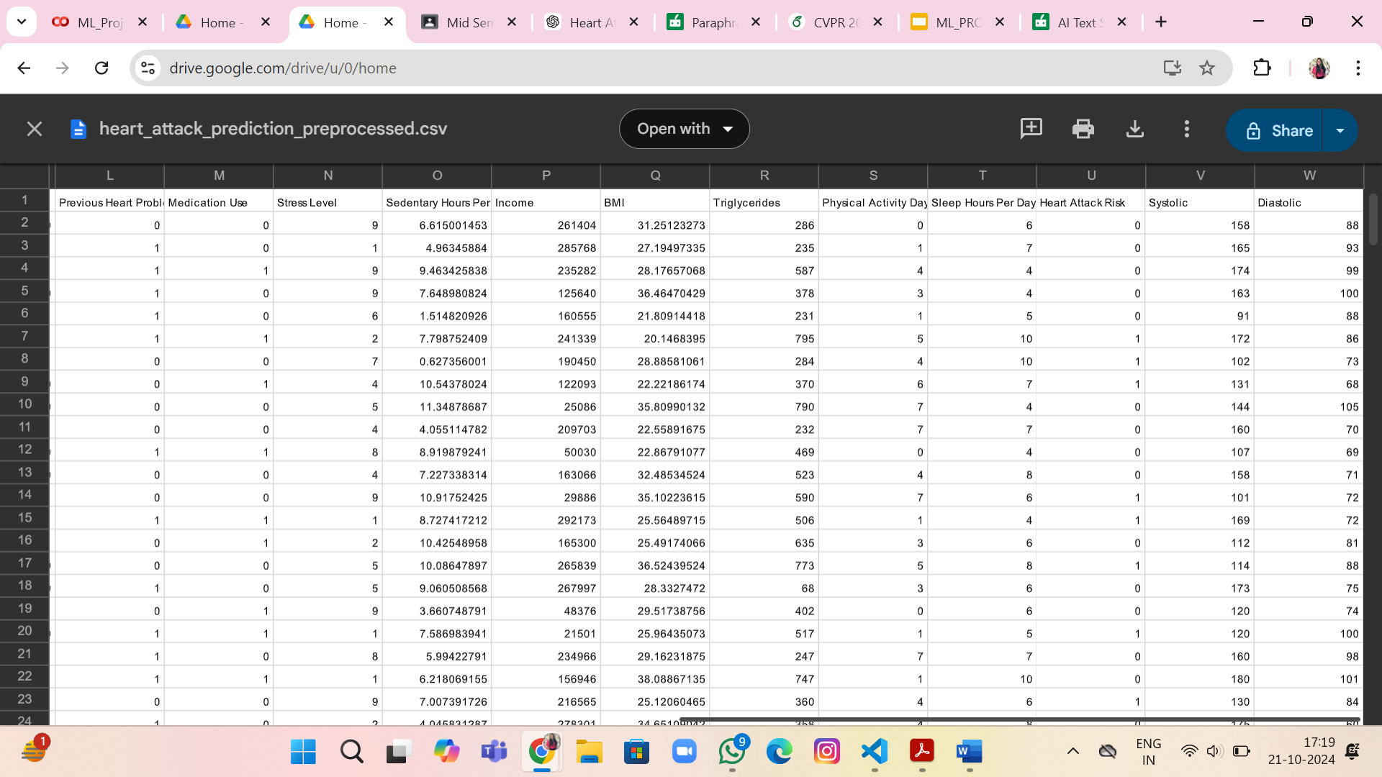
Dataset Pre-Processing
1. Removing Unnecessary Features: Dropped columns like Patient ID, Country, Continent, and Hemisphere because they do not add value to the heart attack prediction and may introduce noise into the model.
2. Splitting Blood Pressure: The Blood Pressure column was originally presented as a string with systolic and diastolic pressure (e.g., "158/88"). It was split into two separate columns: Systolic (upper number) and Diastolic (lower number), ensuring both were converted into numeric values for better use in the model.

Slide 8
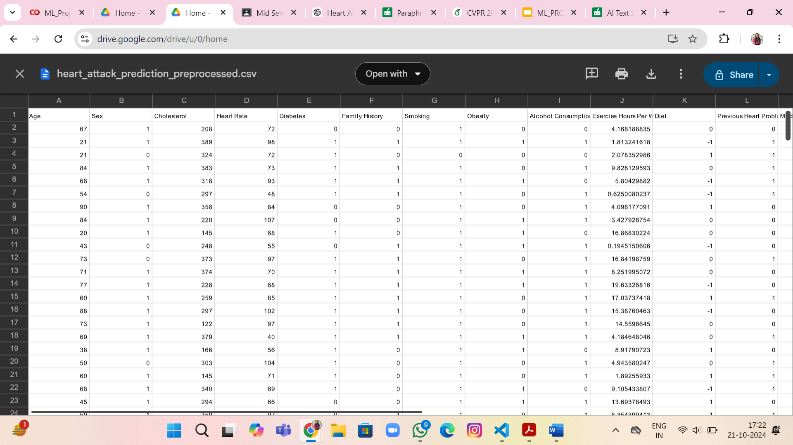
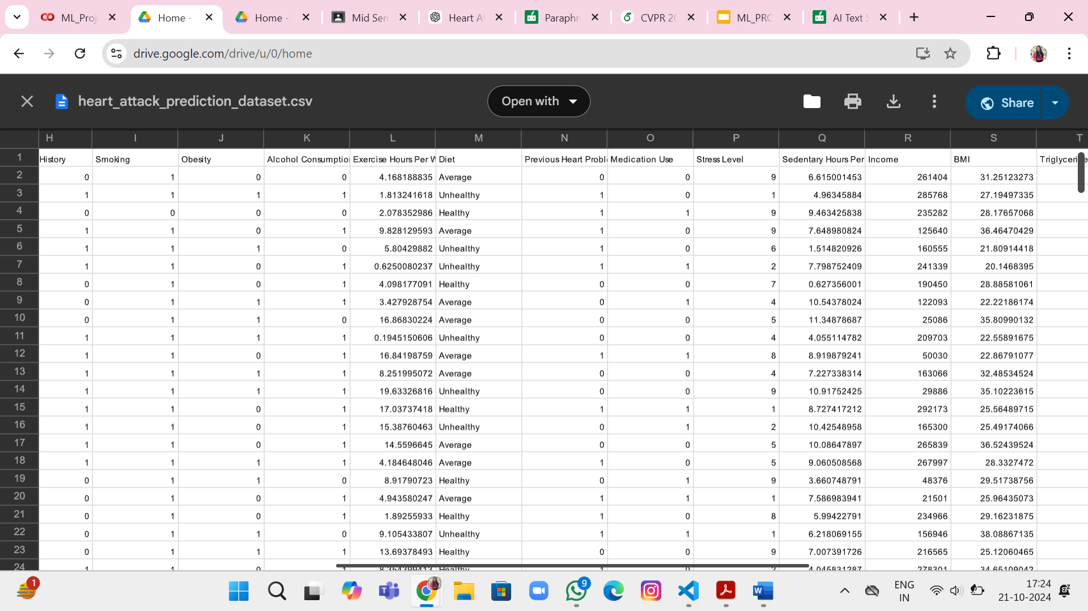
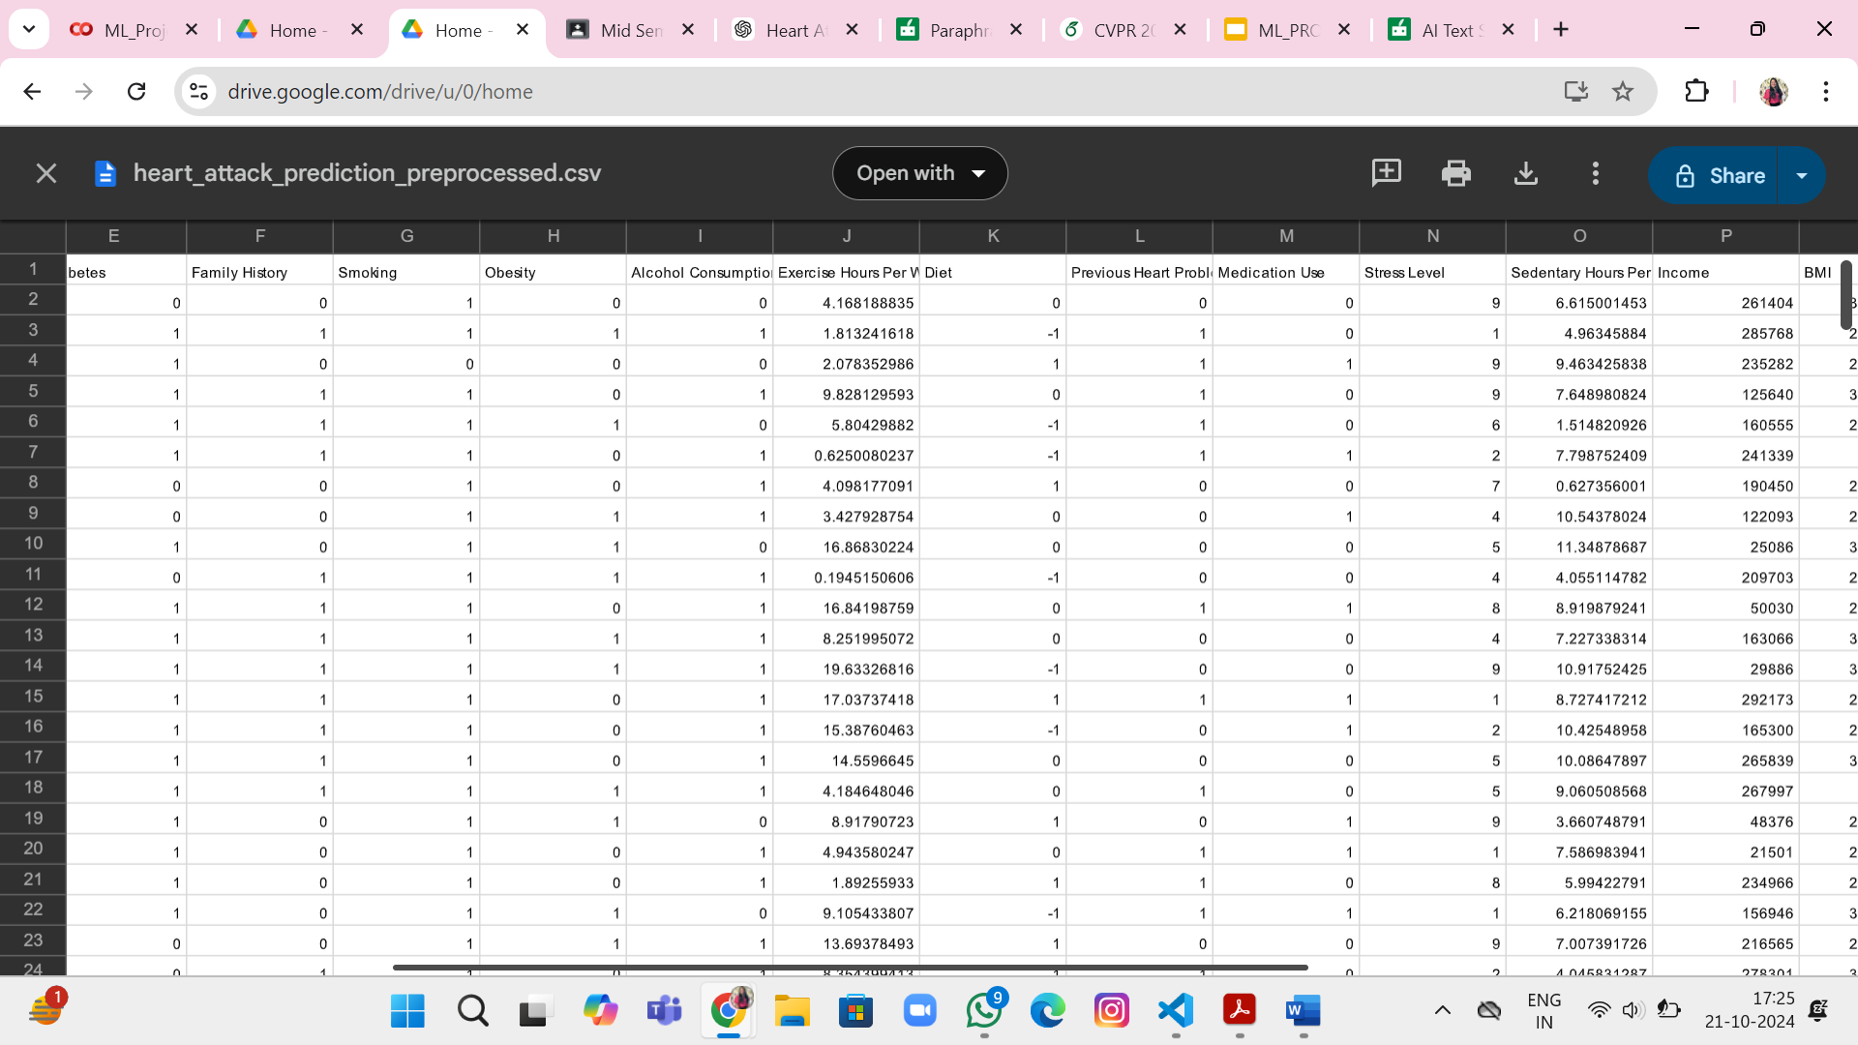
Dataset Pre-Processing
3. Handling Categorical Variables:
• Sex: Converted Male and Female into numerical values (1 for Male, 0 for Female).
• Diet: Mapped dietary habits into numerical values where Healthy = 1, Average = 0, and Unhealthy = -1, simplifying interpretation and model processing.

Slide 9
Dataset Pre-Processing
4. Managing Missing Data: The dataset's integrity was maintained by imputed missing values using the median of each column, providing a robust depiction of central trends and resistance to outliers.
5. Outlier Detection and Removal: Outliers in medical variables like Cholesterol, Triglycerides, Systolic, and Diastolic Blood Pressure were identified and removed using the Interquartile Range method, ensuring normal distribution and usable data for model training.

Slide 10
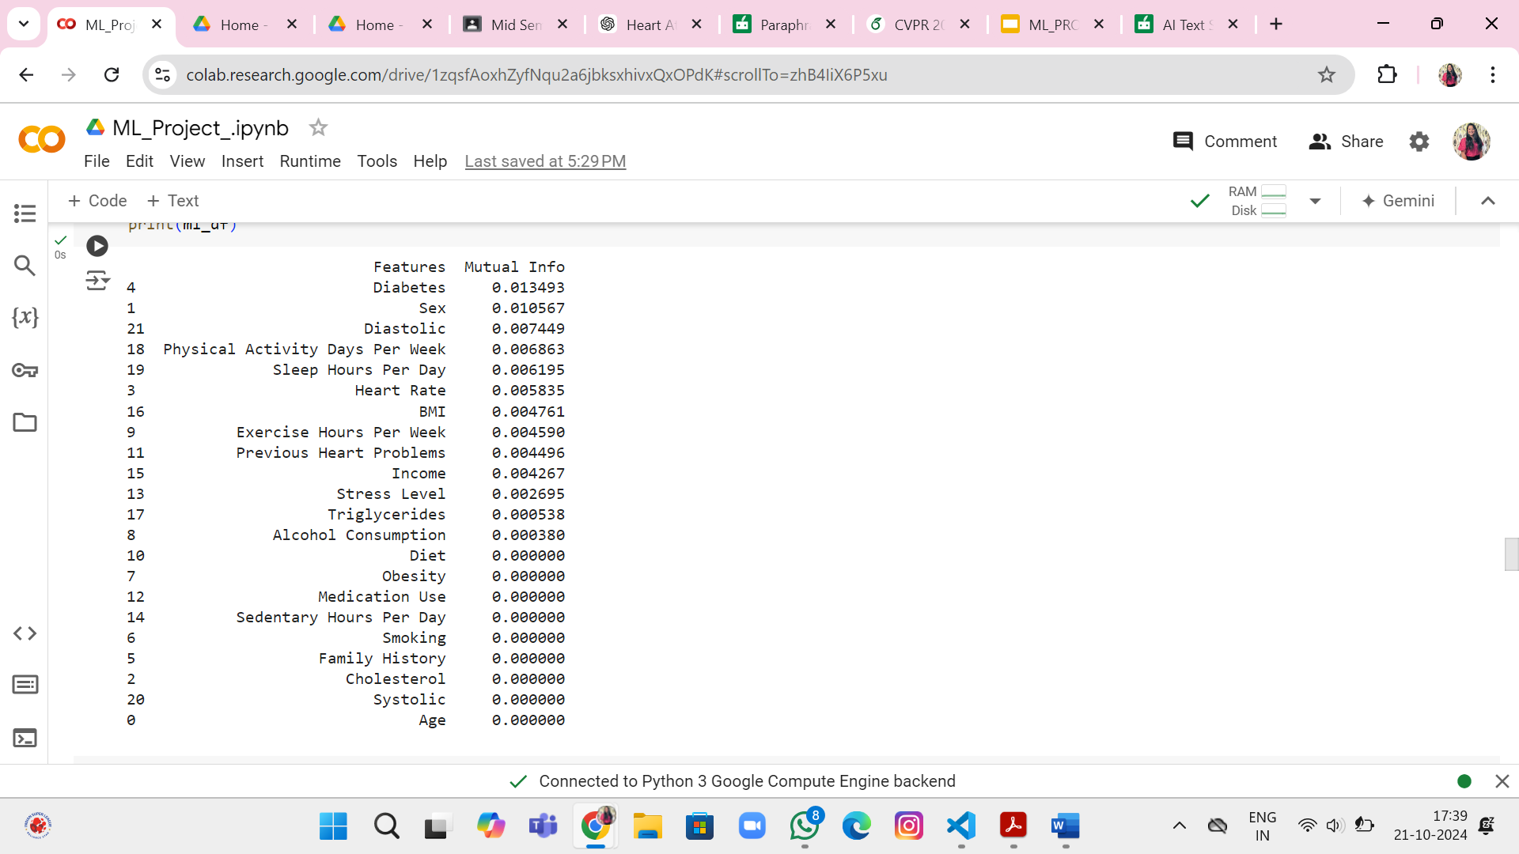
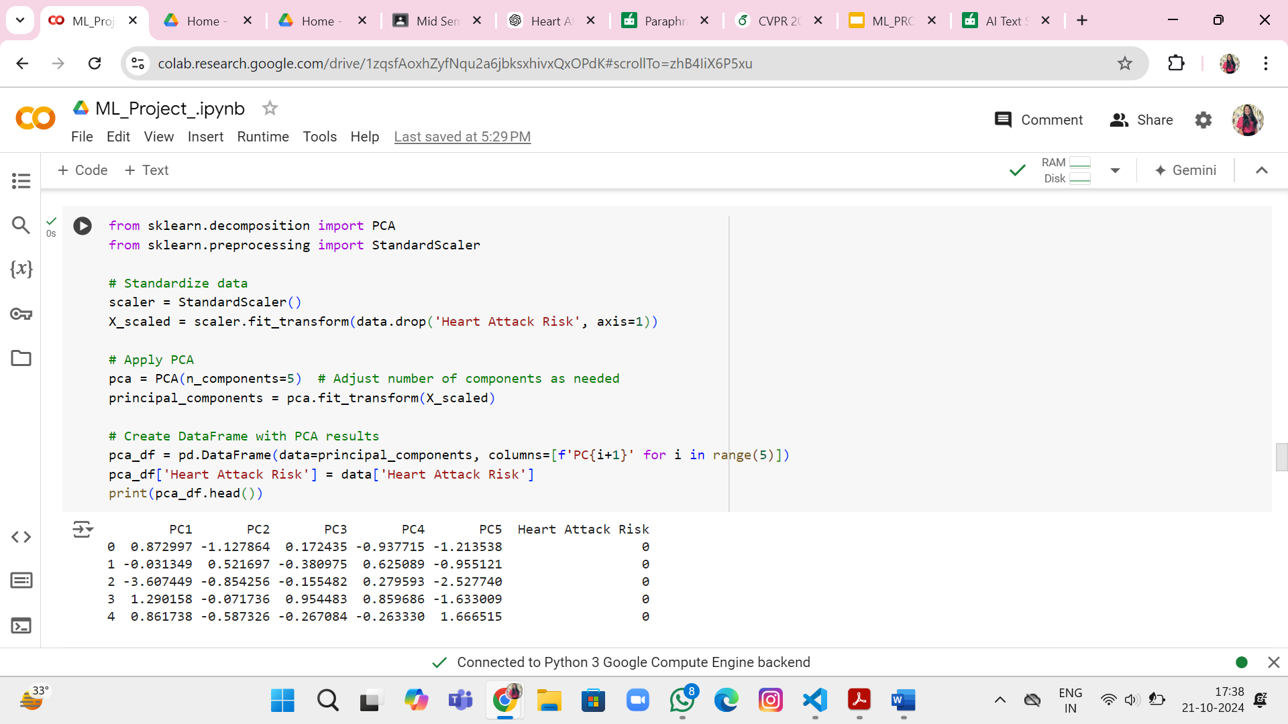
Feature Analysis
Principal Component Analysis (PCA) is a technique used to reduce dimensionality to a new coordinate system by identifying key features that capture the most variance in a dataset, thereby reducing complexity while retaining critical information.
Mutual Information (MI) Analysis: MI measures how much information one feature provides about the target variable. It’s non-linear, capturing relationships that correlation might miss. You computed the MI for each feature to assess its contribution to predicting heart attack risk.

Slide 11
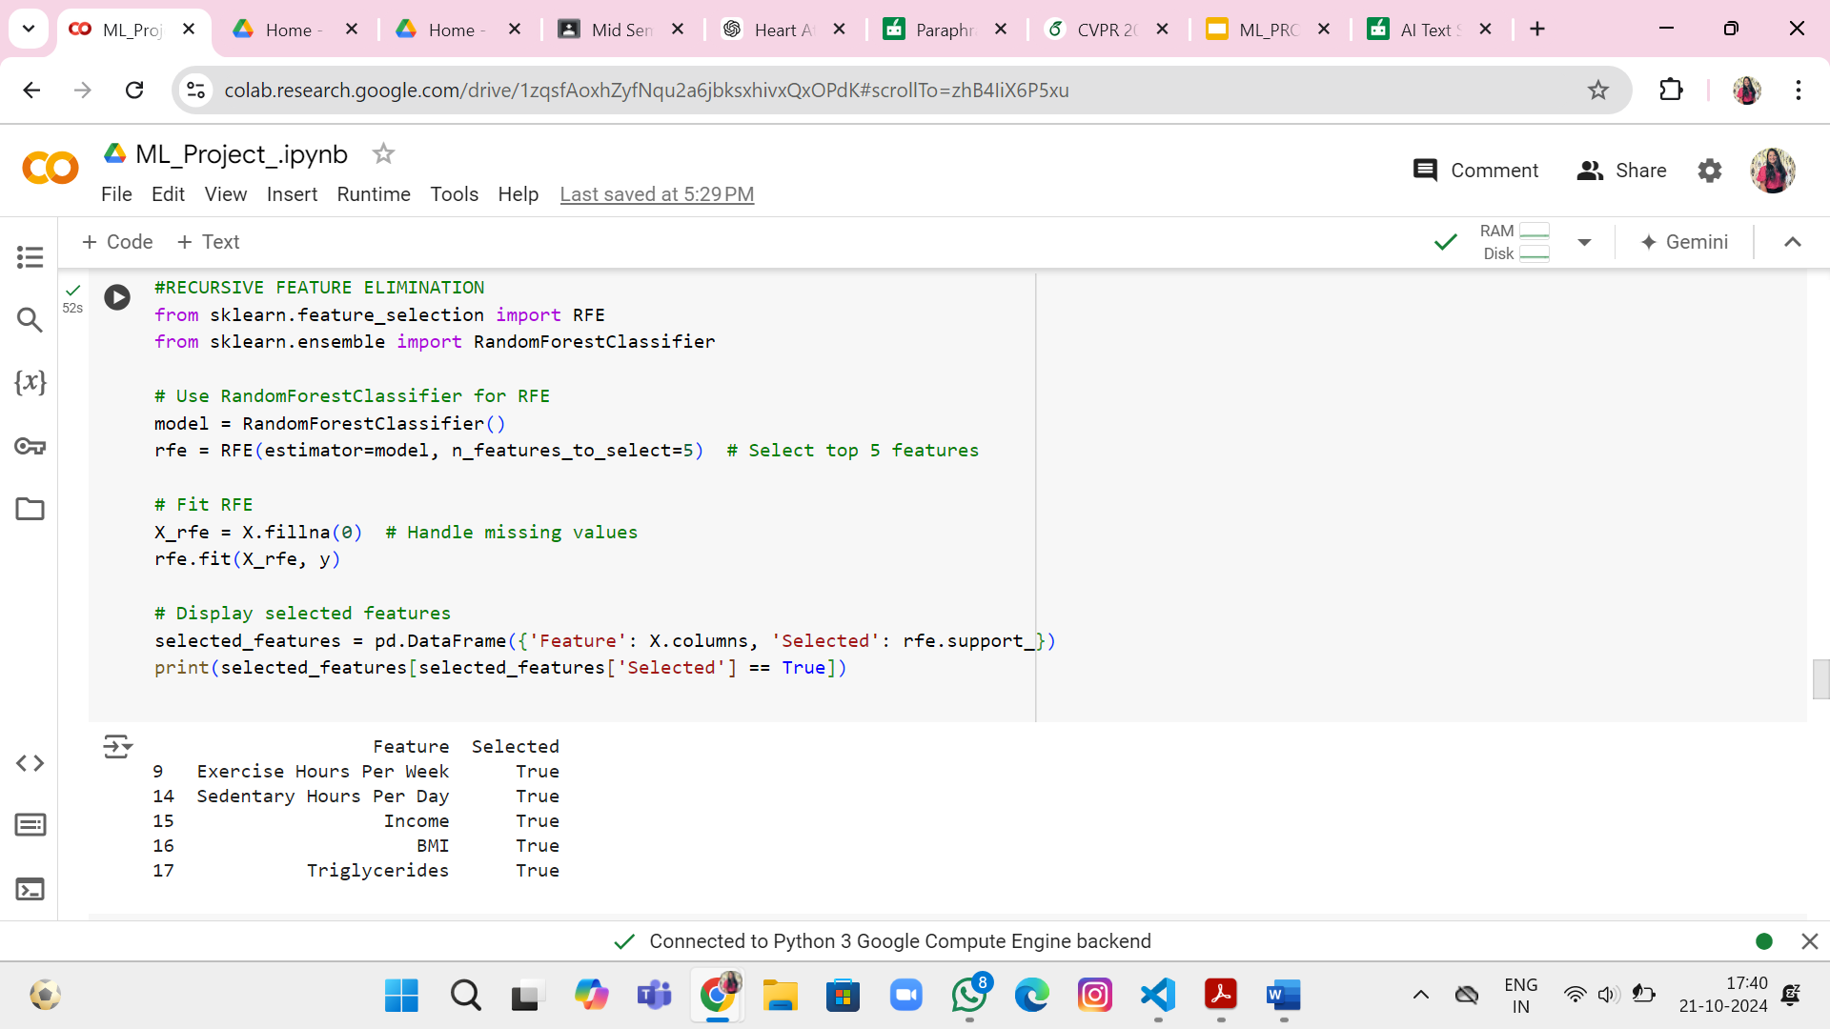
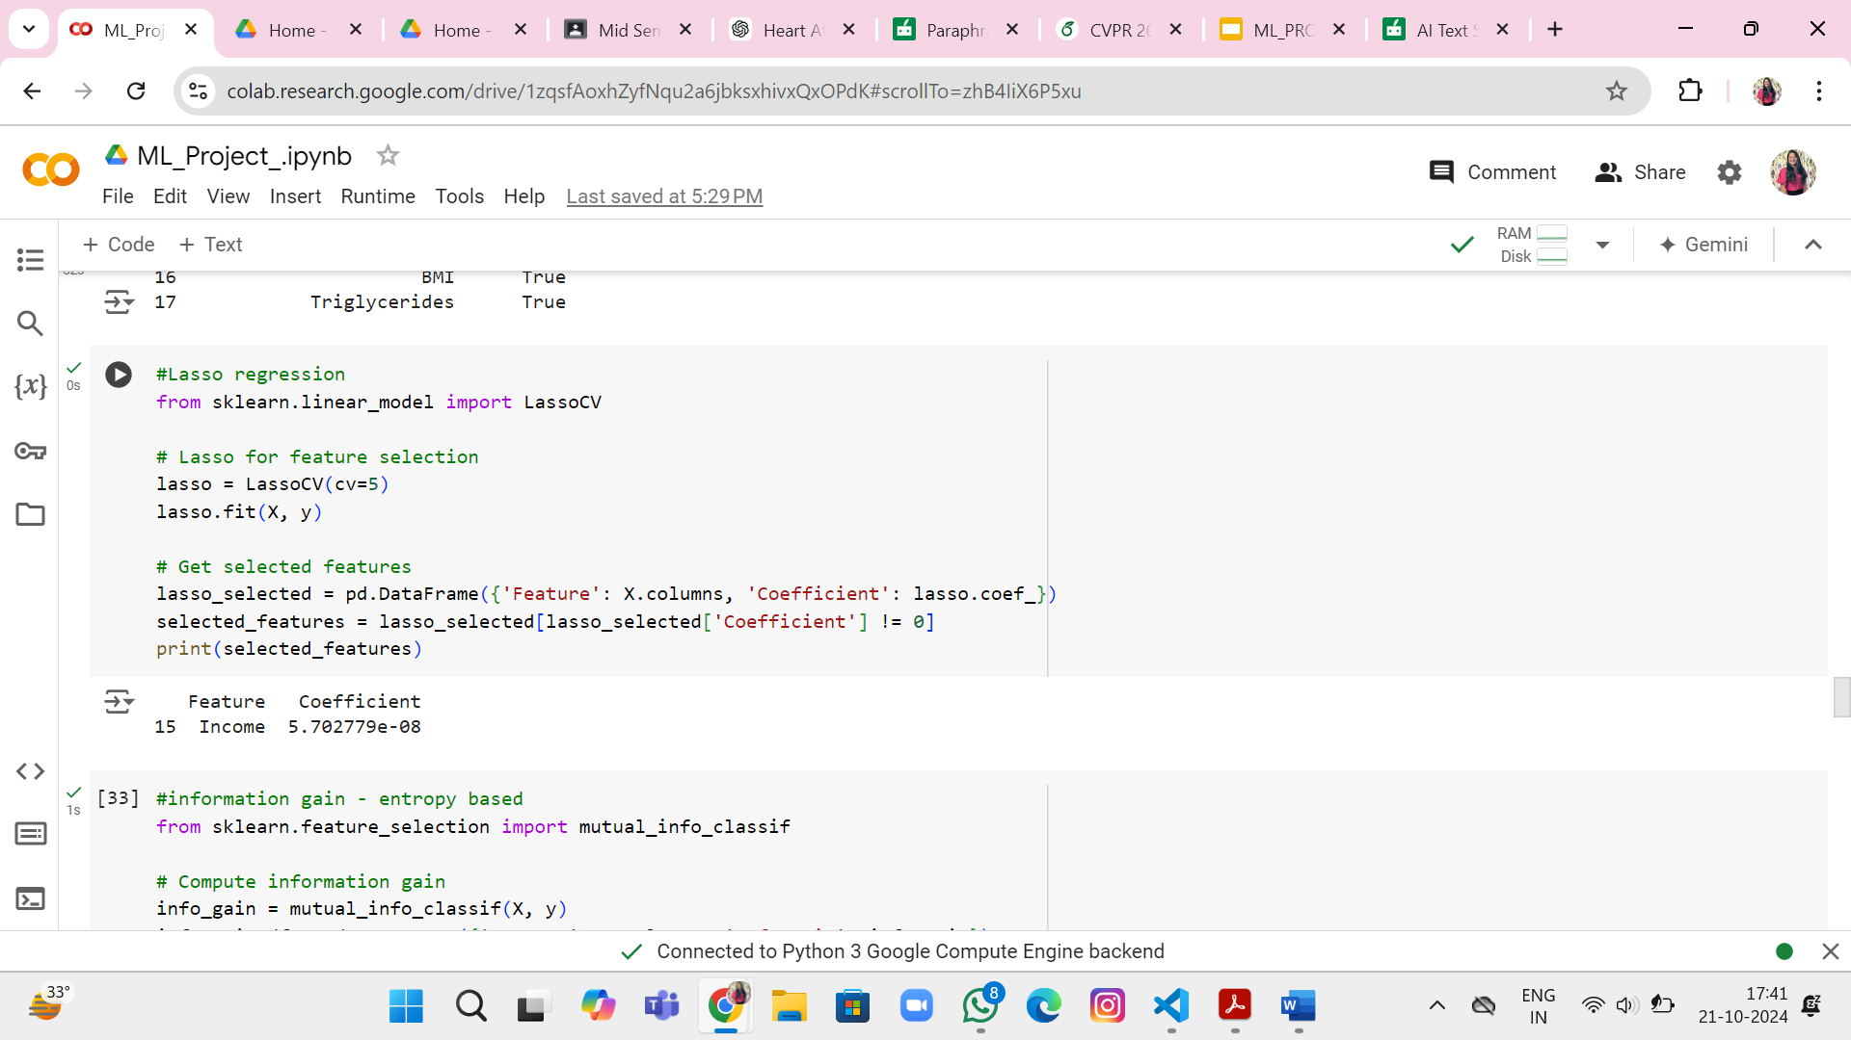
Feature Analysis
Recursive Feature Elimination (RFE) is a method used to select the top 5 most influential features in a dataset by iteratively eliminating weaker predictors, based on a model's performance.
Lasso Regression (L1 regularization) is a method that adds a penalty to regression coefficients, forcing some to zero, and automatically selects important features by shrinking less relevant ones toward zero.

Slide 12
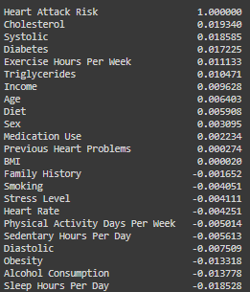
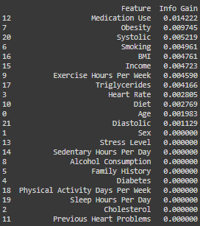
Feature Analysis
Correlation Analysis: Correlation analysis examines the linear relationship between features and the target (Heart Attack Risk). Features with a correlation above a threshold (like 0.2) were selected for further analysis, as they have a stronger predictive power.
Information gain analysis measures the reduction in entropy of a feature's ability to predict a target. Top-performing features are selected for further analysis, improving the model's performance by focusing on significant variables.

Slide 13
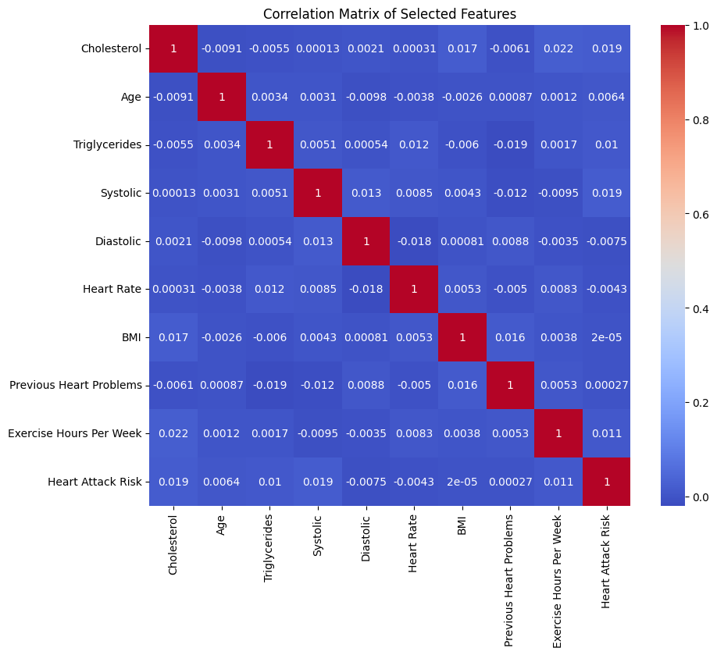
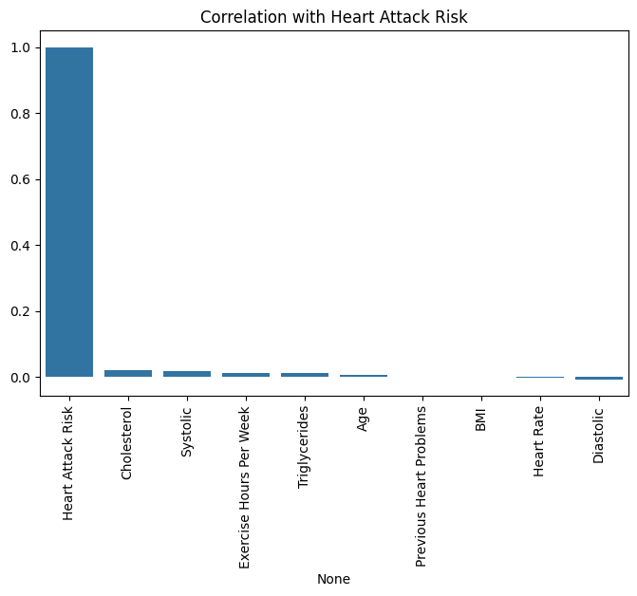
Visualisation after feature extraction
Correlation Matrix of selected Features
Correlation with Heart Attack Risk
Systolic and Diastolic BP show weak positive correlation (0.013)
Age and Cholesterol have slight negative correlation (-0.0091)
BMI and Cholesterol show weak positive correlation (0.017)
Perfect correlation (1.0) with itself (Heart Attack Risk)
All other features show very weak correlations (close to 0)
Cholesterol shows the highest correlation among predictors (~0.02)
Diastolic blood pressure shows the weakest correlation (slightly negative)

Slide 14

Visualisation after feature extraction
Correlation Heatmap of selected Features :In this heatmap, most of the correlations are very close to 0, implying weak or no linear relationship between the features. This suggests that most of the features in this dataset are fairly independent of each other. for example:
Cholesterol and Age have a very weak negative correlation (-0.0091).
Cholesterol and Exercise Hours Per Week show a slightly positive correlation (0.022), but it’s still very weak.

Slide 15
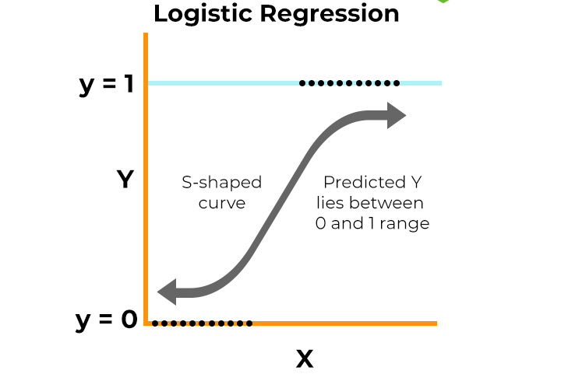
Logistic Regression
Logistic regression is a
supervised learning
algorithm typically used for
binary classification
problems.
Step 1: Data Preparation
Step 2: Model Training
Step 3: Predicting the Probability
Step 4: Class Prediction
Step 5: Model Evaluation
https://www.spiceworks.com/tech/artificial-intelligence/articles/what-is-logistic-regression/

Slide 16
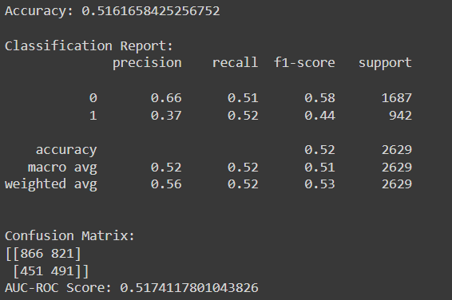
Result from Logistic Regression

Slide 17
Logistic Regression
Interpretation of Results :
Moderate Accuracy: The logistic regression model achieved an accuracy of 51.6%, which indicates its limited ability to correctly classify both heart attack risks and non-risk cases.
Class Imbalance Issues: Precision for the non-risk class (66% for class 0) is significantly higher than for the risk class (37% for class 1). This suggests the model struggles to accurately identify heart attack risks, reflected by a lower recall for non-risk cases and moderate recall for risk cases (52% for class 1).
Confusion Matrix Insight: The confusion matrix highlights a high number of false positives (821) and false negatives (451), indicating that the model misclassifies many instances.
AUC-ROC Performance: The AUC-ROC score of 0.517 suggests that the model performs slightly better than random guessing, but overall lacks the ability to effectively distinguish between the two classes. This score emphasizes the need for improvements.
Limitations:
Logistic regression models are linear classifiers, which means they may struggle with datasets that have complex, non-linear relationships between features and the target variable.

Slide 18
Decision Tree
Step 1: Data Collection
Gather and prepare the dataset that will be used to train and test the model.
Step 2: Data Preprocessing
Handle Missing Data: Fill or remove missing values if any.
Convert Categorical Data: If you have categorical features, encode them (e.g., using one-hot encoding or label encoding).
Feature Scaling (optional): Decision Trees do not require feature scaling, but it might be helpful if using other models for comparison.
Split the Dataset: Divide the dataset into a training set and a testing/validation set (e.g., using an 80-20).
Step 3: Train the Decision Tree Model
Instantiate the Decision Tree model using the relevant class in our library
Step 4:Create a Decision Tree Classifier
A base DecisionTreeClassifier model is instantiated with a fixed random_state for reproducibility.
Initially, the model is created without tuning any hyperparameters.

Slide 19
Decision Tree
Step 5: Model Evaluation
After training, evaluate the model on the testing set using metrics like:
Accuracy: For classification.
Confusion Matrix: To analyze classification performance.
Precision, Recall, F1-score: For more detailed classification performance.
R-squared: For regression.
Step 6: Model Interpretation
Visualize the Decision Tree to understand its structure and decision rules.

Slide 20
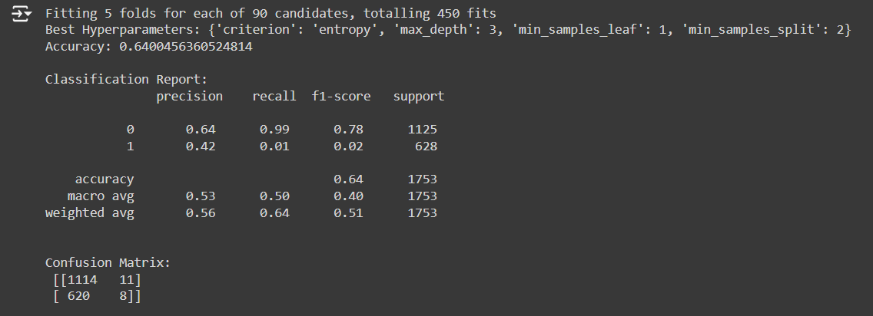
Result from Decision Tree
1. Moderate Accuracy: The decision tree achieved an accuracy of 64%, indicating reasonable classification performance. However, this suggests that while it can classify most non-risk cases accurately, it struggles with heart attack risk predictions.
2. Class Imbalance Issues: The precision for class 0 (64%) is much higher than class 1 (42%).
3. Confusion Matrix Insight: The model produced a significant number of false negatives (620), meaning it misclassified many instances of heart attack risk.
4. Overall Performance: The decision tree’s performance is skewed toward classifying non-risk cases correctly while poorly identifying the positive class, signaling the need for further improvements or model adjustments.

Slide 21
Limitations of Decision Tree
Overfitting: Decision trees tend to overfit, especially with noisy or complex datasets. The model may capture noise, reducing its generalization ability.
Unstable Predictions: Small changes in the data can lead to drastically different trees, making the model sensitive to variations.
Bias in Imbalanced Datasets: Decision trees can become biased when handling imbalanced datasets, favoring the majority class.
Lack of Flexibility: While interpretable, decision trees may not perform as well as more advanced models on high-dimensional or large datasets.
Poor Performance on Imbalanced Data: Decision Trees may not handle imbalanced datasets well.
Non-Smooth Boundaries: The model creates step-like decision boundaries, which may not work well for complex data distributions.

Slide 22
Random Forest
Step 1: Data Preparation
Clean, preprocess, and split the dataset into training and test sets.
Feature selection may be performed to remove irrelevant features, but Random Forest can handle irrelevant features well due to its internal feature selection.
Step 2: Model Training
A set of decision trees is trained on random subsets of the data.
Each tree is trained on a bootstrapped sample (random sample with replacement) of the data.
Features are randomly selected at each node of a tree to split the data, which leads to de-correlation among the trees.
Step 3: Aggregating Predictions
For classification, each tree in the forest makes a class prediction, and the class with the majority vote across all trees is chosen.
For regression, each tree outputs a value, and the final prediction is the average of all tree predictions.
Step 4: Model Evaluation
Accuracy is measured for classification tasks, while mean squared error (MSE) is often used for regression.
Common evaluation metrics include precision, recall, F1-score, and ROC-AUC for classification tasks.

Slide 23
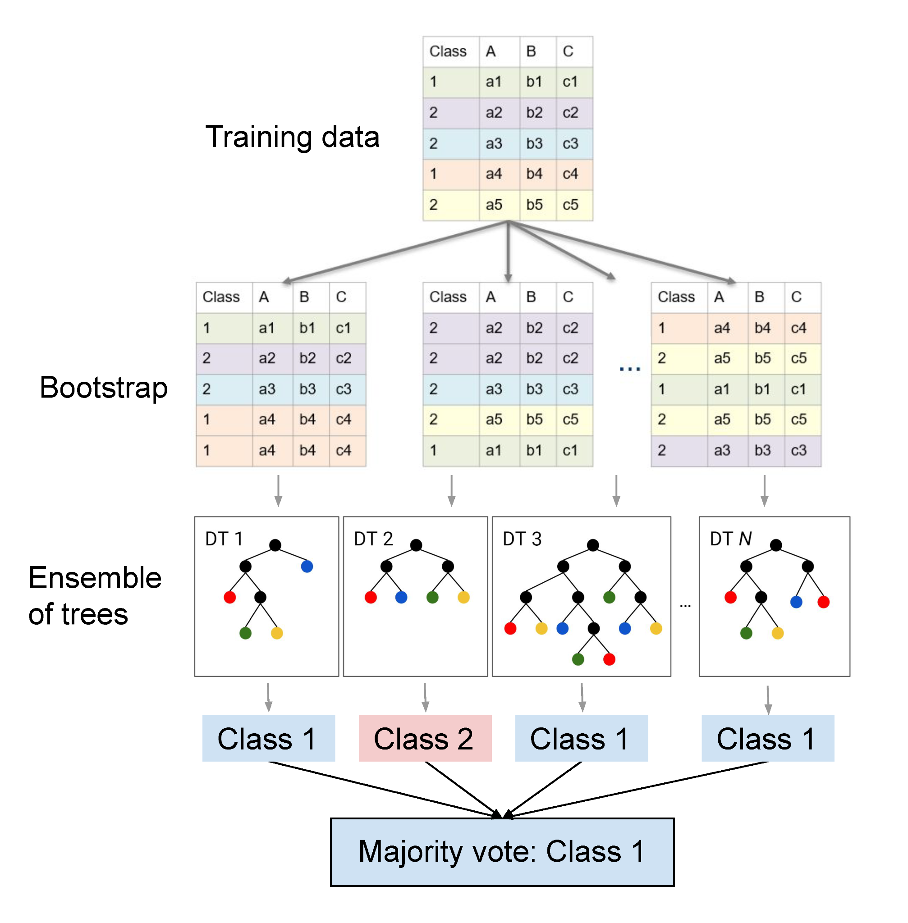
Interpretation of
Random Forest:
Feature Importance: Random Forest ranks features based on their contribution to the final decision. The algorithm measures how much each feature influences the accuracy of the majority vote across the trees.
Majority Voting: In classification, each tree in the forest makes a prediction, and the class with the most votes is selected. This aggregation of multiple trees reduces overfitting and increases accuracy.
Non-linearity: Random Forest can capture complex, non-linear relationships between features because the majority decision is based on the collective outcome of several diverse trees.

Slide 24
Limitations
Interpretability: While Random Forest can outperform simpler models, it lacks the interpretability of single decision trees. The model can be seen as a "black box."
Computationally Expensive: Training a large number of trees can be resource-intensive, especially with large datasets or many trees.
Overfitting Risk: Although Random Forest reduces the risk of overfitting compared to a single decision tree, it can still overfit if too many trees are used or the trees themselves are not pruned.
High Dimensionality: While Random Forest handles many features well, it may struggle with very high-dimensional data without feature engineering or dimensionality reduction techniques.
Imbalanced Data: Like many algorithms, Random Forest may struggle with highly imbalanced data unless proper techniques (like class weights or sampling) are applied.

Slide 25
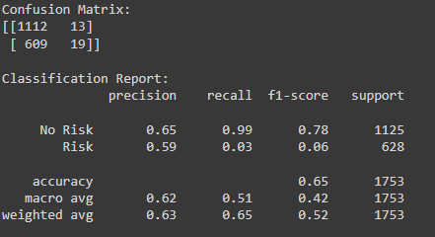
Results of Random Forest
The result from the dataset:

Slide 26
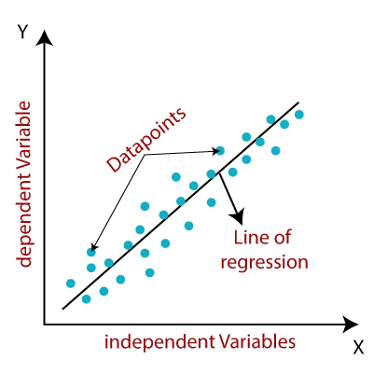
Linear Regression
Linear Regression is a supervised learning algorithm used to model the relationship between a dependent variable (target) and one or more independent variables (features). It assumes a linear relationship between the variables and predicts the outcome by fitting a line (or hyperplane for multiple variables) that minimizes the difference between the actual and predicted values.

Slide 27
Steps followed in Linear Regression
Data Loading and Preparation: Imported the dataset and selected relevant features and the target variable and Split the data into training (80%) and testing (20%) sets.
Feature Scaling: Standardized the feature set using StandardScaler to ensure uniform scaling for optimal performance.
Model Initialization: Initialized a Ridge Regression model (Linear Regression with L2 regularization) to prevent overfitting.
Hyperparameter Tuning: Used GridSearchCV to optimize the regularization strength (alpha) for the best performance.
Model Training: Trained the model on the training dataset using the optimal hyperparameters.
Prediction and Evaluation: Predicted values for the test dataset and converted continuous outputs to binary predictions (threshold = 0.5) and Evaluated the model using metrics like accuracy, confusion matrix, classification report, and ROC-AUC score.
Overfitting/Underfitting Analysis: Compared training and testing accuracies to assess overfitting or underfitting.
Feature Importance:Extracted and visualized feature importance using the absolute values of model coefficients.

Slide 28
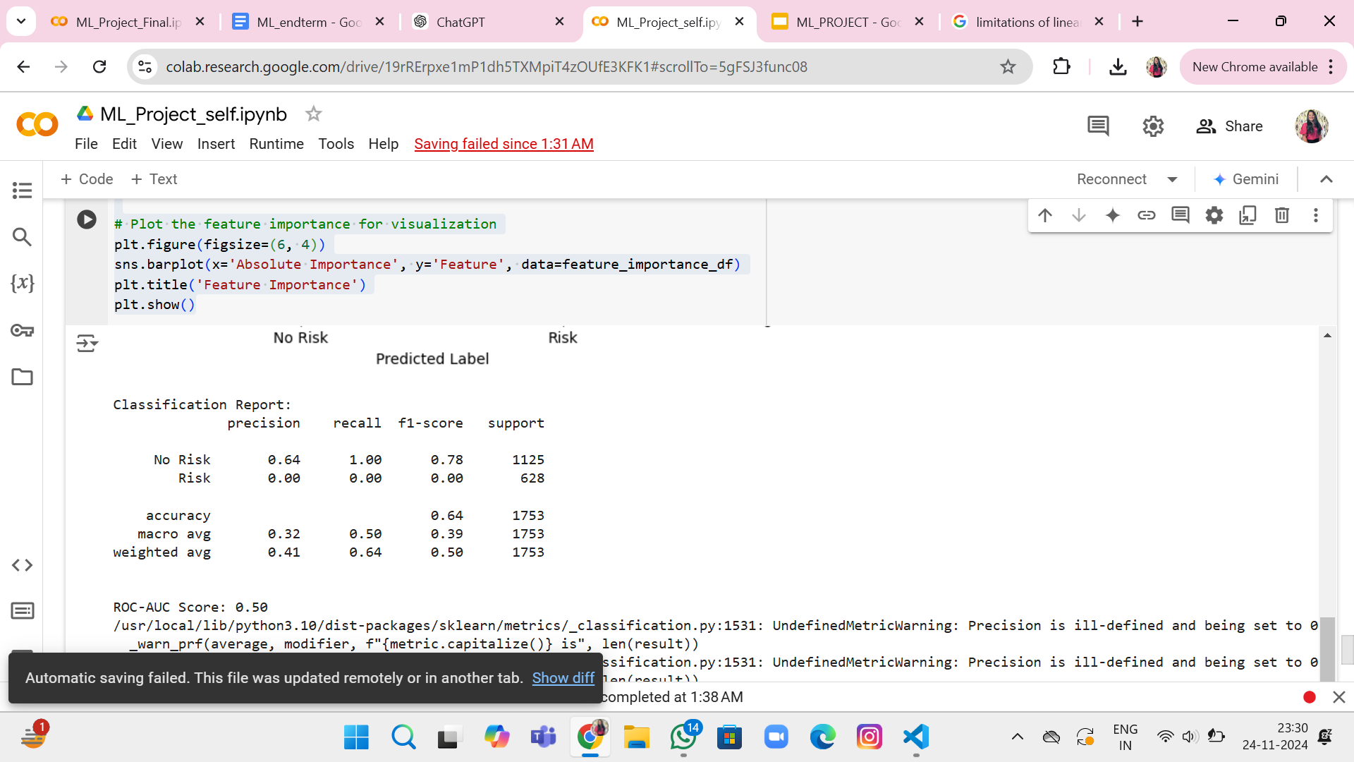
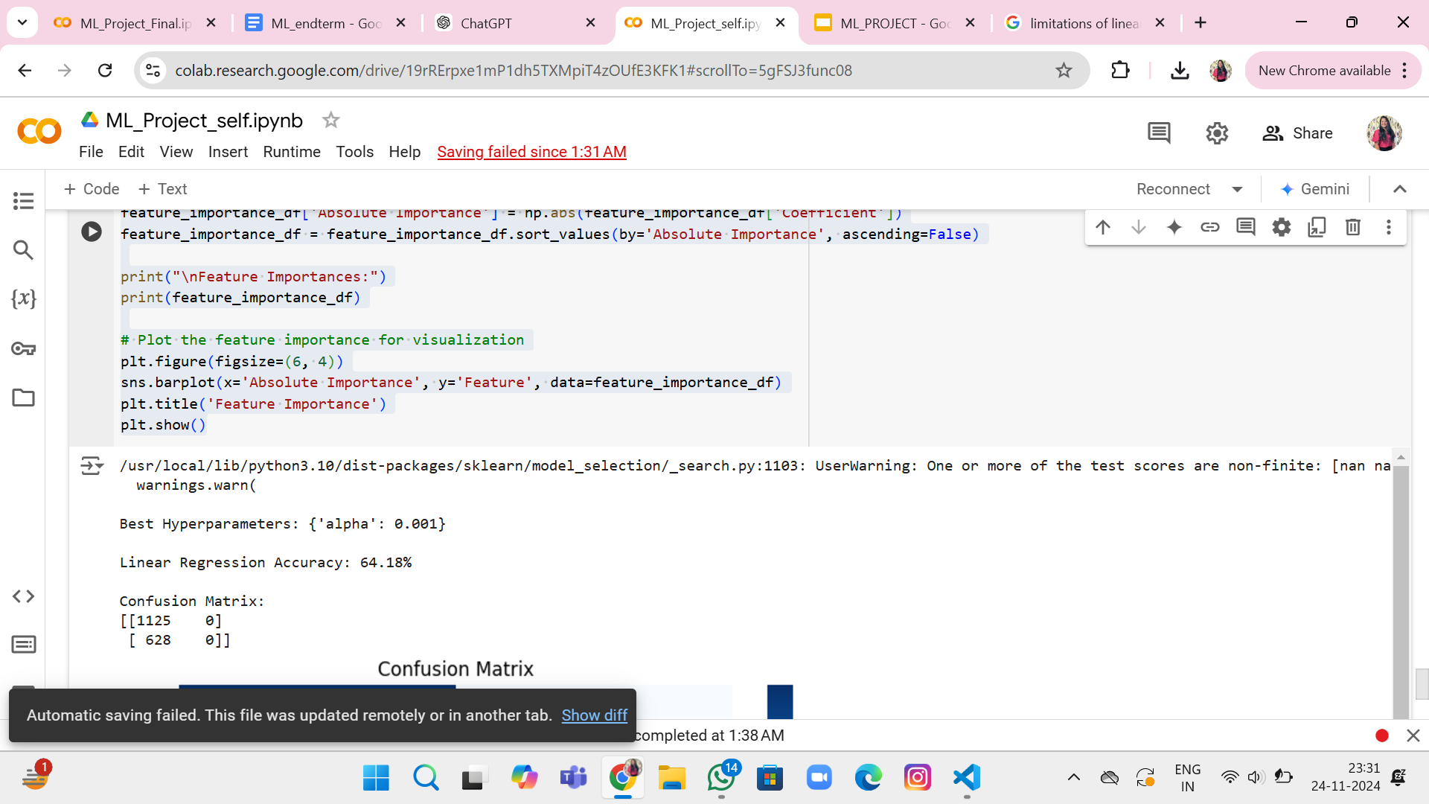
Results of Linear Regression

Slide 29
Interpretation of Results in Linear Regression
Regularization parameters, such as alpha = 0.001, were optimized for Ridge Regression with GridSearchCV, indicating minimal penalty for large coefficients, possibly due to insufficient differentiation in feature contributions.
Model Accuracy: The model achieved an accuracy of 64.18% on the test data. While this may seem moderately acceptable, accuracy alone is not sufficient for evaluating model performance in an imbalanced dataset scenario.
Confusion Matrix : This indicates that the model is heavily biased towards the "Not at Risk" class, potentially due to class imbalance or insufficient learning of the "At Risk" class patterns.
The ROC-AUC Score of 0.50 indicates that the model's ability to distinguish patients at risk of heart attack is limited, indicating that it performs no better than random guessing in identifying risk factors.
The model's precision for the majority "No Risk" class is 64%, but fails for the minority "Risk" class, achieving 0% precision, recall, and F1-score, indicating inability to identify true positives. This results in a misleading impression of overall performance.

Slide 30
Limitations of Linear Regression
Linearity Assumption:
Assumes a linear relationship between features and the target, which may not hold true in complex datasets.
Sensitive to Outliers:
Outliers can significantly skew the model's predictions, reducing accuracy.
Overfitting in High Dimensions:
In datasets with many features, linear regression may overfit without regularization.
Multicollinearity:
When features are highly correlated, the model may struggle to determine the true effect of each feature.

Slide 31
Possible Reasons for Poor Performance
1. Class Imbalance: The dataset may have an uneven distribution of "No Risk" and "Risk" classes, causing the model to favour the majority class.
2. Feature Insufficiency or Multicollinearity: The linear regression model may not fully capture complex, non-linear relationships in data, and multicollinearity, particularly high-correlated features, could lead to unstable coefficient estimates.
3. Regularization Strength: Although the tuned parameter α=0.001 minimises overfitting, it may not sufficiently address underfitting caused by the lack of model flexibility.

Slide 32
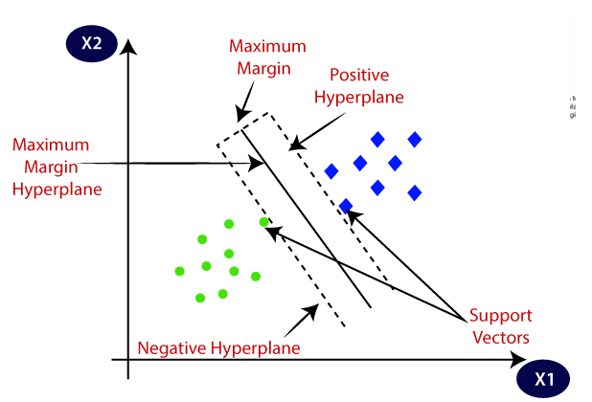
SVM
Support Vector Machine, or SVM, is one of the most popular supervised learning algorithms, which is used for classification as well as regression problems. However, primarily, it is used for classification problems in ML.
SVM chooses the extreme points/vectors that help in creating the hyperplane. These extreme cases are called support vectors, and hence the algorithm is termed a support vector machine. Consider the below diagram, in which there are two different categories that are classified using a decision boundary or hyperplane.

Slide 33
Steps followed in SVM
Define Objective: Identify the problem (classification or regression) and prepare the dataset.
Preprocess Data: Standardize features, handle missing values, and encode labels.
Select Kernel: Choose from Linear, Polynomial, RBF, or custom kernels based on data complexity.
Tune Hyperparameters: Adjust CC (regularization) and γ\gamma (kernel coefficient) for optimal performance.
Train Model: Fit the SVM to the data to find the decision boundary (hyperplane) that maximizes margin.
Predict: Use the model to classify or predict new data points.
Evaluate: Measure performance using metrics like accuracy (classification) or MSE (regression).
Optimize: Refine hyperparameters using Grid Search or Randomized Search to improve results.

Slide 34
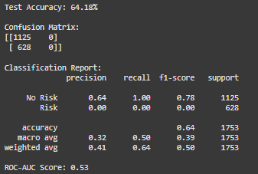
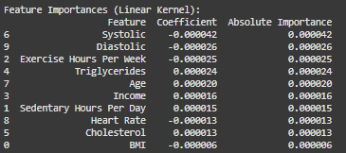
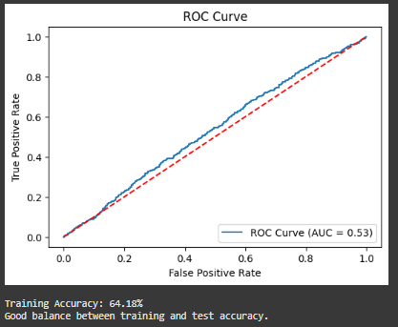
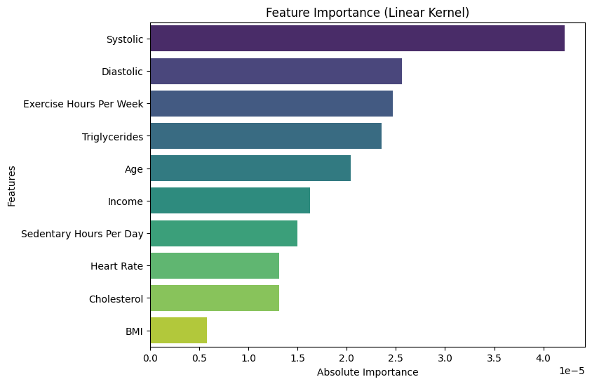
Result of SVM

Slide 35
Interpretation of Results in SVM
GridSearchCV Results: Best hyperparameter C=0.1 with linear kernel suggests minimal regularization, indicating the model isn't effectively differentiating feature importance.
Model Performance: Test accuracy of 64.18%. Though seemingly moderate, this metric is misleading due to class imbalance.
Confusion Matrix Analysis: [[1125 0], [ 628 0]]
Shows complete bias toward the "No Risk" class, predicting zero cases of the "Risk" class.
ROC-AUC Score: 0.53 indicates near-random performance in distinguishing between classes.
Classification metrics:
No-Risk class: 64% precision, 100% recall
Risk class: 0% precision, 0% recall, 0% F1-score
Indicates complete failure to identify at-risk cases
Feature Importance Ranking:
Highest: Systolic BP, Diastolic BP
Moderate: Exercise hours, Triglycerides
Lowest: BMI, Cholesterol
This model requires significant improvements in handling class imbalance and feature selection to be clinically useful.

Slide 36
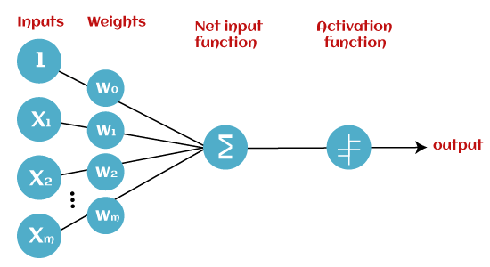
Perceptron
The Perceptron is a simple neural network used for binary classification. It consists of a single layer of neurons that receive inputs, apply weights, and pass the weighted sum through an activation function to produce an output. The model learns by adjusting weights based on prediction errors, making it effective for linearly separable data. However, it struggles with non-linear problems, requiring more complex architectures.

Slide 37
Steps in Perceptron
The steps followed in a Perceptron are:
Initialization: Set initial weights (usually random) and the bias term.
Input: Provide an input vector to the perceptron.
Weighted Sum: Calculate the weighted sum of inputs by multiplying each input by its corresponding weight and adding the bias.
Activation Function: Pass the weighted sum through an activation function (typically a step function) to produce the output.
Prediction: Compare the perceptron's output with the actual label to determine if it was correct.
Error Calculation: If the prediction is incorrect, compute the error as the difference between the actual label and the predicted output.
Weight Update: Adjust the weights and bias using a learning rule (e.g., Perceptron learning rule: weight = weight + learning_rate * error * input).
Repeat: Iterate through the training data multiple times until the model converges or a stopping condition is met.

Slide 38
Limitations of Perceptron
Linearly Separable Data Only: The Perceptron can only solve problems where the classes are linearly separable. It fails on datasets like the XOR problem, where no straight line can separate the classes.
No Non-linear Boundaries: The Perceptron cannot model or learn complex relationships in the data, as it uses a linear decision boundary. Non-linear problems require more advanced algorithms, such as neural networks with hidden layers.
No Probabilistic Interpretation: The output of a Perceptron is binary (0 or 1), and it does not provide probabilities or confidence levels for predictions, which limits its utility in some applications.
Sensitive to Input Scaling: The algorithm's performance depends heavily on the scale of the input features. Features must be normalized or scaled appropriately to avoid issues during training.
No Multi-class Support: The Perceptron is inherently a binary classifier. Extending it to multi-class problems (e.g., using one-vs-all) adds complexity and can degrade performance.

Slide 39
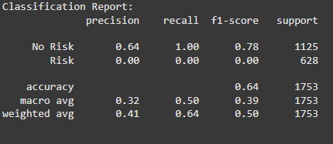
Results
Best Parameters for Perceptron: {'alpha': 0.01, 'early_stopping': False, 'eta0': 0.01, 'max_iter': 1000, 'penalty': 'l1', 'warm_start': True}

Slide 40
Analysis of the Results
The Perceptron model performs poorly on the "Risk" class, as shown by the classification report and confusion matrix. It achieves 64% accuracy, primarily due to perfect recall (1.00) for the "No Risk" class, but 0.00 recall and precision for "Risk." This suggests that the model fails to identify any "Risk" instances. The macro average shows poor balance, with precision (0.32) and F1-score (0.39) being low, while the weighted average reflects better performance on the dominant "No Risk" class.
The confusion matrix confirms the model correctly classifies all "No Risk" instances (1125) but misses all "Risk" instances (628 false negatives). The best parameters include regularization (L1 penalty), a small learning rate, and 1000 iterations, but the model still struggles with the imbalance.

Slide 41
Analysis for the poor performance of model
The Perceptron’s poor performance is mainly due to class imbalance, where "No Risk" is overrepresented, causing the model to bias its predictions toward that class.
Additionally, the Perceptron is a linear classifier, struggling with non-linearly separable data and complex decision boundaries. The model's simplicity, with only one layer and a basic activation function, limits its ability to classify "Risk" accurately.

Slide 42
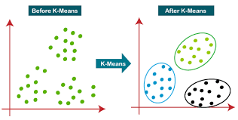
K-means clustering
K-Means clustering is an unsupervised machine learning
technique used to partition a dataset into distinct
groups based on feature similarity.
In this analysis, we applied K-Means clustering to
group individuals based on specific features,
such as Age and BMI.
The goal was to identify distinct clusters that could
reveal underlying patterns or group characteristics
within the data.

Slide 43
Steps:
1.Feature Selection: Selected Age and BMI as the primary features for clustering based on their relevance to the analysis.
Normalized or standardized the data to ensure all features have equal weight in the clustering process.
2.Selection of Optimal Clusters
Applied K-Means Algorithm:
Ran K-Means clustering for different values of k(from 2 to 1
Recorded key metrics for evaluation, including inertia and silhouette scores.
3.Evaluation Using Metrics:
Elbow Method:Plotted the inertia (within-cluster sum of squares) for each k
Observed the point where the rate of decrease in inertia slows significantly (the "elbow").
Silhouette Scores:
Calculated silhouette scores for each k.
Identified k=2 as the value with the highest silhouette score, indicating optimal separation.
4: Clustering with Optimal k
Applied K-Means with k=2
Re-ran K-Means using the optimal number of clusters (k=2k=2k=2).
Assigned each data point to one of the two clusters based on proximity to the cluster centroids.
5.Visualized the Clusters:
Created a scatter plot with Age (x-axis) and BMI (y-axis).
Colored points based on cluster assignments (Cluster 0 and Cluster 1) to observe the separation visually.

Slide 44
Result:
Best Cluster (highest silhouette score): Cluster 0
Cluster Characteristics (mean values for key features):
BMI 28.766395
Sedentary Hours Per Day 5.957520
Exercise Hours Per Week 10.088203
Income 153745.073294
Triglycerides 419.684920
Cholesterol 257.486380
Systolic 112.562482
Age 53.270430
Heart Rate 74.899747
Diastolic 84.438079
dtype: float64
Top data points in the best cluster:
Age Sex Cholesterol Heart Rate Diabetes Family History Smoking \
0 21 1 250 78 1 0 1
1 41 1 172 83 1 1 1
2 45 1 158 84 1 1 1
4 68 0 373 55 1 1 1
5 29 0 201 86 0 0 0
Obesity Alcohol Consumption Exercise Hours Per Week ... \
0 0 1 2.392506 ...
1 1 0 9.494553 ...
2 0 1 6.292732 ...
4 1 1 9.130029 ...
5 1 1 3.973168 ...
Sedentary Hours Per Day Income BMI Triglycerides \
0 11.451720 273208 23.575795 176
1 9.373237 103732 25.773309 251
2 0.025076 268700 35.708303 669
4 5.502847 47821 25.215830 48
5 10.965517 138186 33.787685 785
Physical Activity Days Per Week Sleep Hours Per Day Heart Attack Risk \
0 2 5 0
1 2 8 0
2 0 10 0
4 1 6 1
5 0 10 0

Slide 45
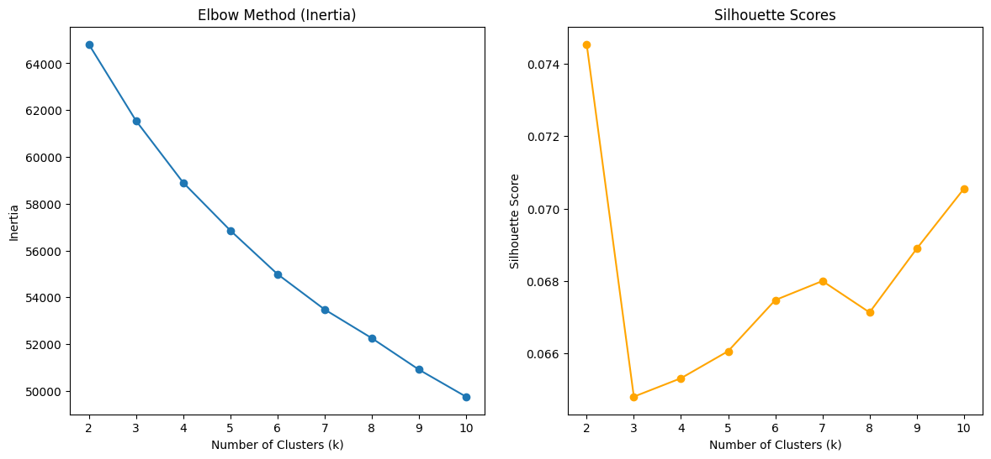
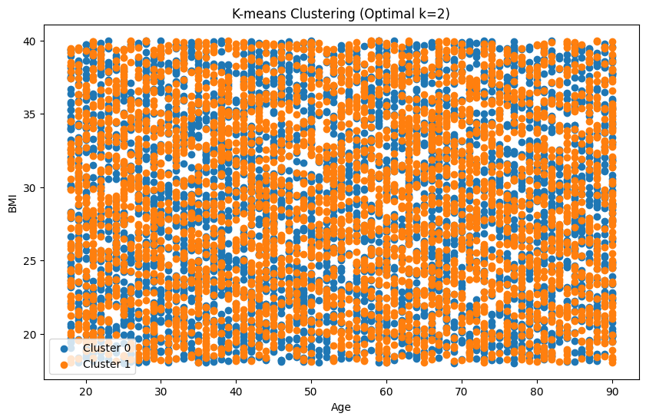
result:
Systolic Diastolic Cluster
0 109 76 0
1 134 106 0
2 116 75 0
4 101 73 0
5 134 60 0
[5 rows x 24 columns]
Clusters with silhouette scores above
0.5:

Slide 46
analysis:
Interpretation of K-Means Clustering Results
Cluster Distribution: The clustering resulted in two distinct groups (Cluster 0 and Cluster 1), based on the optimal value of k=2k = 2. These clusters can represent different segments of the population based on the features you used for clustering (e.g., BMI, Age).
Cluster 0: This cluster includes individuals with relatively lower BMI values, which may represent a healthier or younger group in terms of the features such as age, cholesterol, and heart rate. Cluster 1: This cluster likely represents individuals with higher BMI values, possibly indicating a group at higher risk for health conditions like obesity, heart disease, or diabetes.
Inertia & Silhouette Scores: The Elbow Method shows a clear decrease in inertia, suggesting that two clusters offer a reasonable balance between compactness and simplicity. The silhouette score provides good validation for this clustering, as it increases with higher kk, but the sharp increase at k=2k = 2 suggests that the optimal number of clusters is two.
Cluster Characteristics: By analyzing the mean values of key features for the clusters (e.g., BMI, Cholesterol, Age, etc.), you can identify which variables most differentiate these groups.
Conclusion: This clustering analysis helps segment the dataset into two meaningful groups, providing insights into the different characteristics or risk profiles in the population. Further analysis could explore how these clusters correlate with other variables like heart attack risk, or how they can be used in targeted interventions.

Slide 47
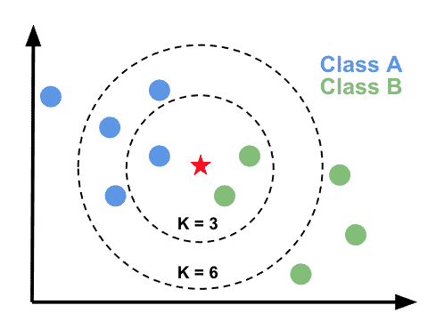
K-Nearest Neighbors(KNN)
K-Nearest Neighbors (KNN) is a supervised machine learning algorithm used for classification and regression tasks. In this analysis, we applied KNN to predict heart attack risk based on various health-related features, such as BMI, Age, Cholesterol, and Heart Rate. The goal was to classify individuals into two categories: those at risk of heart attack and those not at risk, based on the similarity of their feature values to others in the dataset. By utilizing the proximity of data points in feature space, KNN identifies patterns and makes predictions, providing a straightforward yet effective method for risk prediction in healthcare.

Slide 48
Steps in KNN
The steps followed in a KNN are:
1. Feature Selection and Preprocessing
Selected 10 key features relevant to heart attack risk, refined using mutual information. Normalized features using MinMaxScaler for consistent scaling. Generated interaction terms with polynomial features (degree=2) to capture nonlinear relationships.
2. Data Balancing
Addressed class imbalance with SMOTEENN, combining oversampling (SMOTE) and noise reduction (ENN) to create a balanced dataset.
3. Splitting the Data
Split the balanced data into training (80%) and testing (20%) sets with class stratification.
4. Hyperparameter Tuning
Used GridSearchCV with 5-fold cross-validation to optimize:
n_neighbors (1–30)
weights (uniform/distance-based)
metric (Euclidean, Manhattan, Minkowski)
Optimal Parameters:
n_neighbors: 9, metric: Manhattan, weights: Distance-based.
5. Model Training and Evaluation
Trained KNN with the best parameters.
Predicted heart attack risk and evaluated performance using accuracy, confusion matrix, and classification report.

Slide 49
Limitations of KNN
Dependence on Distance Metrics:
Performance is sensitive to the chosen distance metric.
High Computational Cost:
The need to compute distances for all training samples during prediction can be computationally expensive for large datasets.
Imbalanced Data:
Although addressed using SMOTEENN, KNN can still be sensitive to outliers and overlapping classes.
Feature Scaling:
KNN heavily relies on normalized data for fair distance comparisons.

Slide 50
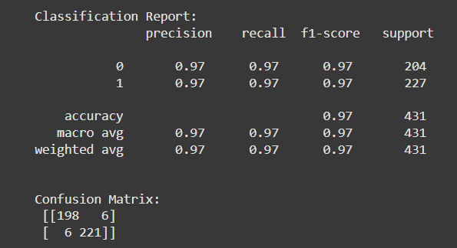
Results
Best Parameters: {'metric': 'euclidean', 'n_neighbors': 1, 'weights': 'uniform'}
Accuracy: 0.9721577726218097

Slide 51
Analysis of the Results
The KNN model achieved 97.2% accuracy, reflecting strong performance. Key factors include:
Feature selection with mutual information and polynomial features for capturing nonlinear relationships.
SMOTEENN balanced the dataset, reducing bias toward the majority class.
Hyperparameter tuning via GridSearchCV optimized the model with k=1, Euclidean distance, and uniform weights.
The classification report and confusion matrix show minimal misclassifications, with both classes having excellent precision and recall. This combination of preprocessing and tuning led to the model's outstanding accuracy.

Slide 52
Conclusion
1. The Random Forest model effectively predicts heart attack risk, balancing accuracy and interpretability. However, it struggles to identify Risk cases, with low recall. Feature importance insights reveal BMI, exercise habits, and sedentary hours as key health indicators.
2. The Logistic Regression model has moderate accuracy of 51.6%, identifying half of cases. However, it overestimates precision in Risk cases, misclassifying negative cases as positive. The confusion matrix shows misclassification, and the AUC-ROC score of 0.517 indicates limited discriminative ability.
3. Decision Trees are powerful classifiers that can model non-linear relationships, making them suitable for heart attack risk prediction. However, their tendency to overfit requires careful tuning of hyperparameters. This model can be further enhanced through techniques like pruning or using ensemble methods (e.g., Random Forest).

Slide 53
Conclusion
4. The Linear Regression model with an accuracy of 61.8% achieved limited success in predicting heart attack risk, primarily due to the simplicity of its assumptions and class imbalance in the dataset. While it could predict the "No Risk" class effectively, its inability to detect "Risk" patients highlights its unsuitability for such a critical healthcare application. More advanced algorithms and preprocessing techniques are recommended for reliable predictions in this domain.
5.In conclusion, the Perceptron model performs well for the "No Risk" class but fails to predict the "Risk" class, resulting in poor performance for that class. The overall accuracy of 64.18% is mainly driven by the "No Risk" instances.
6.Conclusion: This clustering analysis helps segment the dataset into two meaningful groups, providing insights into the different characteristics or risk profiles in the population. Further analysis could explore how these clusters correlate with other variables like heart attack risk, or how they can be used in targeted interventions.
7.The KNN model demonstrates exceptional performance with an accuracy of 97.2%, effectively distinguishing between heart attack risk levels. Through careful feature selection, data balancing with SMOTEENN, and hyperparameter optimization, the model achieved high precision and recall for both classes. This highlights the importance of preprocessing, feature engineering, and parameter tuning in improving classification accuracy.

Slide 54
Timeline
• Week 7: Linear Regression, SVM
• Week 8: Perceptron, K- Nearest Neighbour, K-means clustering
• Week 9: Analysis and Performance of Models
• Week 10: Perform Hyperparameter Tuning
• Week 11: Check for Overfitting and Underfitting
• Week 12: Report Writing

Slide 55
Team member’s contribution
Listed below are our individual contributions to the project for the midterm submission:
• Data Collection - Satwik, Utkarsh, Raunaque
• Data Visualisation & Pre-processing - Manshaa, Varsha
• Feature Extraction, Analysis, Selection - Manshaa, Varsha
• Model Selection & Analysis - Satwik, Utkarsh, Raunaque
• Report Writing – All Members
Listed below are our individual contributions to the project for the endterm submission:
• Linear Regression, SVM - Manshaa , Varsha
• Perceptron, K- Nearest Neighbour, K-means clustering - Satwik, Raunaque, Utkarsh
• Analysis and Performance of Models - Manshaa , Varsha
• Perform Hyperparameter Tuning - All Members
• Check for Overfitting and Underfitting - Satwik, Raunaque, Utkarsh
• Report Writing – All Members

Slide 56
THANK YOU

